Slide 1
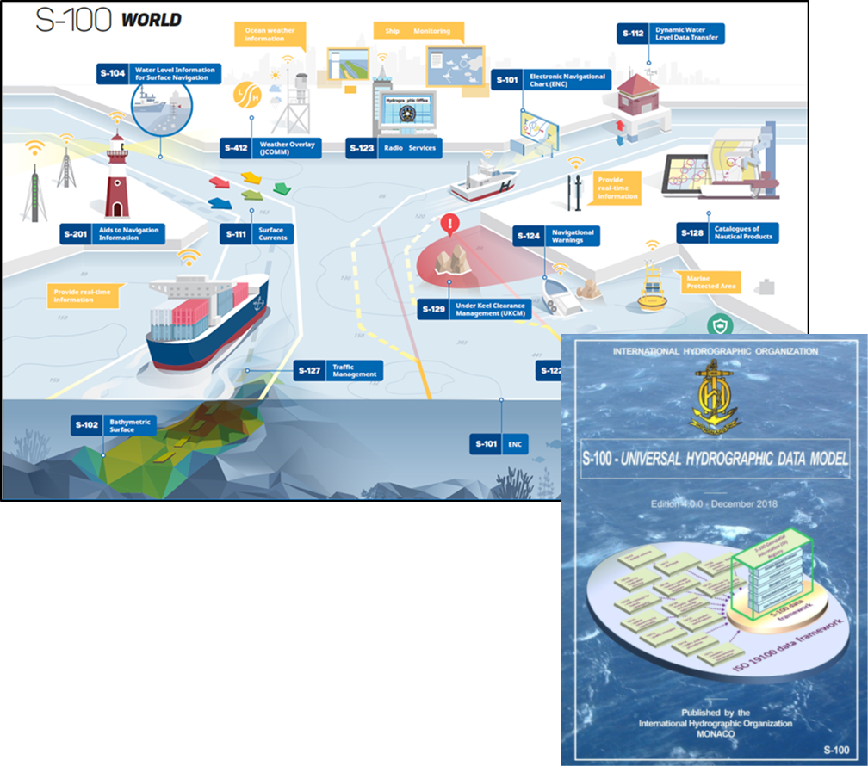
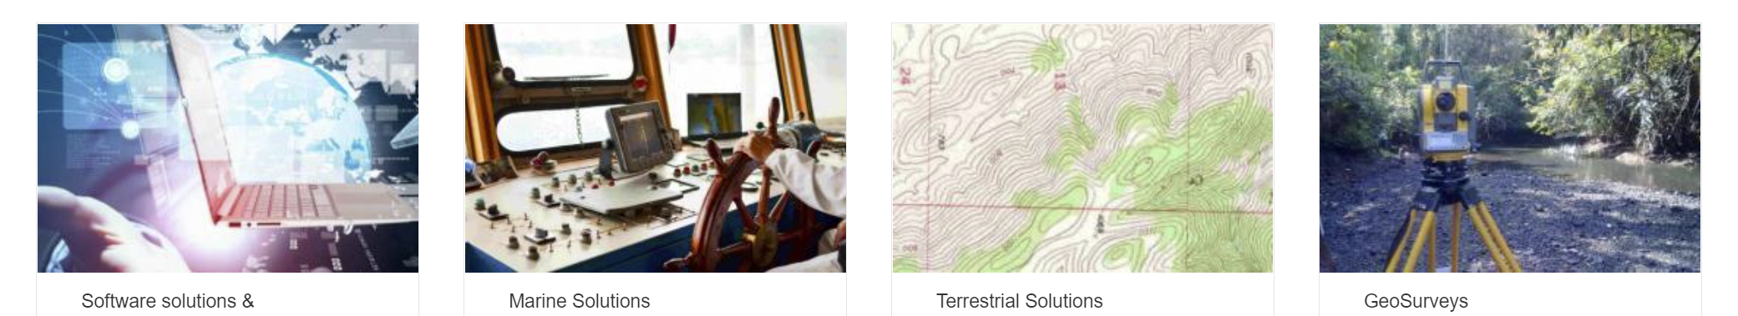

IIC Technologies
IIC Technologies provides solutions and services for the acquisition, management, integration and dissemination of geospatial data.
Global Presence – Clients in over 30 countries
End-to-end geospatial solutions to the Aeronautics, Defense, Government, Infrastructure, Marine, Oil & Gas, Transportation and Utility sectors.
Marine Sector.
Production of Marine Charts and publications data for Navigation
Consultants on international standards for hydrography with over 25 years experience in pioneering digital navigation
Senior Consultants specializing in modelling, development, data production and cross-sectoral integration.
Notes:
Our Senior consultant for the testbed project is Jonathan Pritchard. Jonathan has over 20 years experience in the geospatial industries and over 30 years experience in the technology sector. Via cryptography and the telecommunication industry, Jonathan joined IIC Technologies from the United Kingdom Hydrographic Office, one of the foremost marine geospatial mapping agency in the world. He has over 20 years experience within geospatial standards working groups in the International Hydrographic Organization and is one of the current founding co-chairs of the OGC’s Marine Domain Working Group. He carries out development and consulting work in a wide variety of fields concerning marine geospatial data across the IHO, ISO and Un-GGIM groups. He was technical lead for the OGC’s Maritime Limits and boundaries Pilot Project, where the foundations of integration between the IHO’s S-100 framework and OGC web services were laid.

Slide 2
“Using the IHO’s S-100 framework as a representation of data content and modelling, execute an OGC API reference implementation of S-100 metadata and S-128 content for advanced dataset discovery”
The objectives of the research are:
Demonstrate how IHO S-100 marine data can be discovered using existing OGC API Records methodologies and the ISO 19115 metadata embedded in S-100 datasets and service discovery metadata within ISO S-128.
Setup a testbed for a region with multiple S-100 datasets and service definitions in S-128 and provide dataset discoverability services using OGC API methodologies.
Feedback to the OGC community, primarily through OGC MDWG, and IHO and through the upcoming revision to S-100 (edition 5.0.0) on any modifications to the standards base to more easily enable interoperability between the two frameworks.
Produce a documented initial approach detailing how the discoverability elements can be used as a prototype to develop full OGC/IHO interoperability and the potential for such interoperability.

Slide 3
The approach
The objective is to make IHO marine geospatial metadata available through OGC API Records
OGC API Records (draft) is an extension of OGC API Common with metadata specific elements within the API structure.
What is metadata? It’s “data about data”
OGC reflects this by making the API methodology for describing metadata (records) an extension of the API for data content itself…
data
about
data
IHO Standards don’t do it this way…
Metadata is encoded in XML using ISO templates (for 19115)
Data Content is modelled using the S-100 General Feature Model and described using S-100’s Feature Catalogue (XML)
They’re both XML but stem from different models.

Slide 4
The approach
The objective is to make metadata available through OGC API Records
OGC API Records (draft) is an extension of OGC API Common with metadata specific elements within the API structure.
OGC reflects this by making the API methodology for describing metadata (records) an extension of the API for data content itself…
What is metadata? It’s “data about data”
data
about
data
IHO Standards don’t do it this way…
Metadata is encoded in XML using ISO templates (for 19115)
Data Content is modelled using the S-100 General Feature Model and described using S-100’s Feature Catalogue (XML)
They’re both XML but stem from different models.

Slide 5
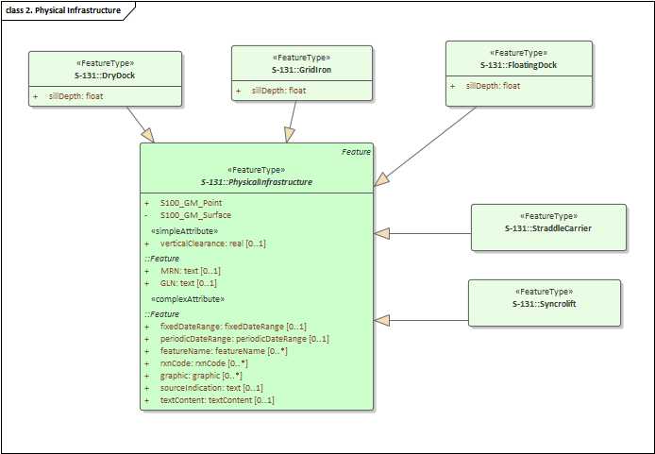
Defining Data in IHO S-100
Data structures are defined using a restricted set of UML primitives (defined in the framework) and building an application schema.
Then a Feature Catalogue is (manually) built from the Application Schema
The Feature Catalogue is then used to define datasets which conform to the feature catalogue.
Encodings can be either raster (HDF5) or Vector (ISO8211 or GML)
Each product specification can extend the generic metadata with their own fields by extending the generic S-100 metadata XML Schema
Examples:
S-101 – electronic charts
S-102 – Dense Bathymettry
S-127 – Vessel Traffic Management
Model
<S100FC:S100_FC_FeatureCatalogue xmlns:S100Base="http://www.iho.int/S100Base" <S100FC:name>Feature Catalogue for S-127</S100FC:name> <S100FC:scope>Global coverage of maritime areas</S100FC:scope> <S100FC:fieldOfApplication>Marine Traffic Management</S100FC:fieldOfApplication> <S100FC:versionNumber>1.0.0-20181129</S100FC:versionNumber> <S100FC:versionDate>2018-11-29</S100FC:versionDate> <S100FC:producer> <S100CI:role>publisher</S100CI:role> <S100CI:party> <S100CI:CI_Organisation> <S100CI:name>International Hydrographic Organization</S100CI:name> <S100CI:contactInfo> <S100CI:address> <S100CI:deliveryPoint>International Hydrographic Organization, 4 quai Antoine 1er, B.P. 445</S100CI:deliveryPoint> <S100CI:postalCode>MC 98011 MONACO CEDEX</S100CI:postalCode> </S100CI:address> <S100CI:contactInstructions>Contact IHO NIPWG Chair</S100CI:contactInstructions> </S100CI:contactInfo> </S100CI:CI_Organisation> </S100CI:party> </S100FC:producer> <S100FC:classification>unclassified</S100FC:classification> <S100FC:S100_FC_SimpleAttributes> <S100FC:S100_FC_SimpleAttribute> <S100FC:name>Administrative Division</S100FC:name> <S100FC:definition>Administrative division is a generic term for an administrative region within a country at a level below that of the sovereign state.</S100FC:definition> <S100FC:code>administrativeDivision</S100FC:code> <S100FC:valueType>text</S100FC:valueType> </S100FC:S100_FC_SimpleAttribute>
Feature Catalogue

Slide 6
= derived from
API metadata
API data
API
data
Feature Catalogue
GML Schema
Model
metadata
Metadata
(+)
Extension
?
metadata
(metadata)
Feature Catalogue
Metadata
Model

Slide 7
METADATA
So a slightly different approach for metadata is to model it using the S-100 general feature model
Use the same data modelling approach for metadata as data
But use OGC Records API “attributes” and sub-attributes
Then we can make metadata as an extension of S-100 data
Conforms to S-100 GFM
“native types”
Similar to OGC API philosophy
This is (sort of) what IHO S-128 does…
metadata
(metadata)
Feature Catalogue
Metadata
Model

Slide 8
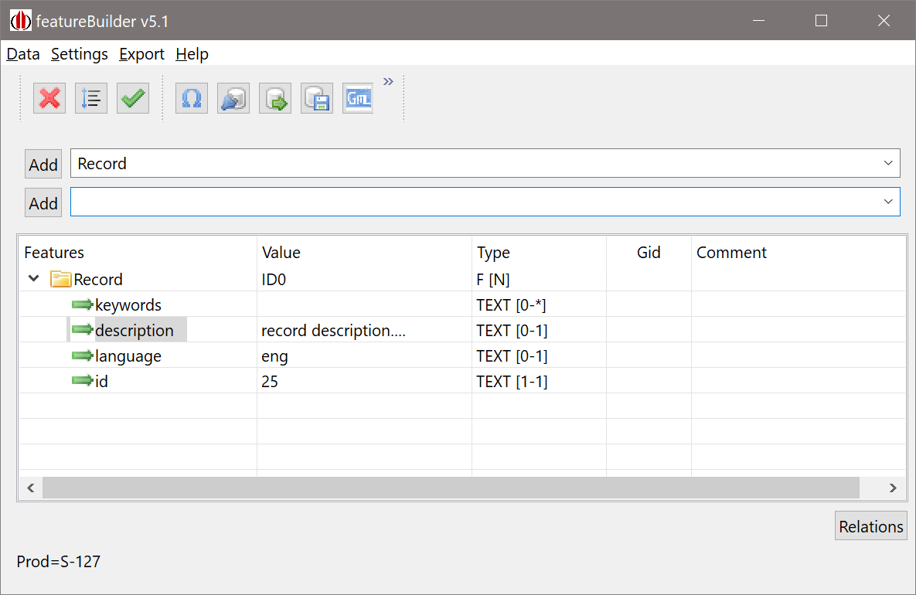
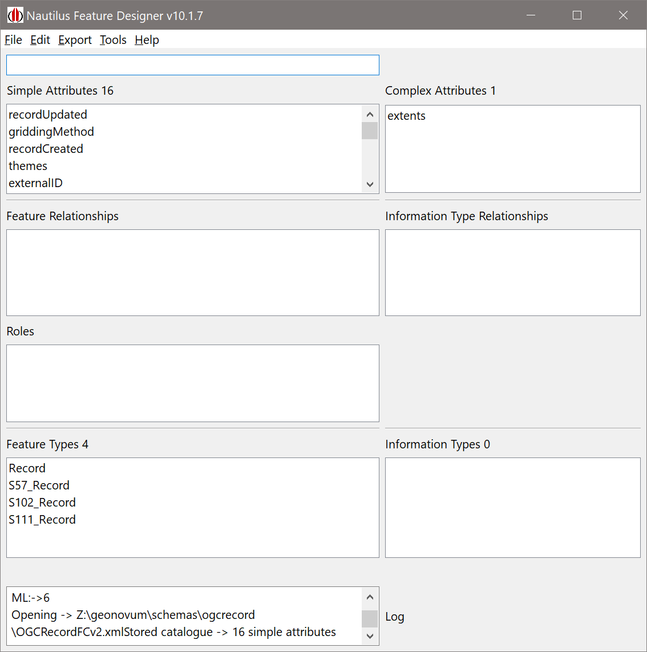
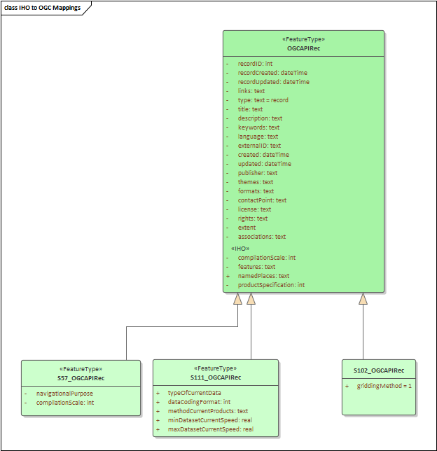
<S100FC:name>OGCRecordsFC</S100FC:name> <S100FC:scope>global</S100FC:scope> <S100FC:fieldOfApplication>none</S100FC:fieldOfApplication> <S100FC:versionNumber>0.0</S100FC:versionNumber> <S100FC:versionDate>2021-10-29+01:00</S100FC:versionDate> <S100FC:producer> <S100CI:role>author</S100CI:role> <S100CI:party> <S100CI:CI_Organisation> <S100CI:name>None</S100CI:name> <S100CI:contactInfo> <S100CI:address> <S100CI:city>Frome</S100CI:city> <S100CI:administrativeArea>Somerset</S100CI:administrativeArea> <S100CI:country>UK</S100CI:country> <S100CI:electronicMailAddress>jp@jpsworldoffun.com</S100CI:electronicMailAddress> </S100CI:address> <S100CI:onlineResource> <S100CI:linkage>www.iictechnologies.com</S100CI:linkage> </S100CI:onlineResource> </S100CI:contactInfo> </S100CI:CI_Organisation> </S100CI:party> </S100FC:producer> <S100FC:classification>unclassified</S100FC:classification> <S100FC:S100_FC_SimpleAttributes> <S100FC:S100_FC_SimpleAttribute> <S100FC:name>recordUpdated</S100FC:name> <S100FC:definition>recordUpdated</S100FC:definition> <S100FC:code>recordUpdated</S100FC:code> <S100FC:alias></S100FC:alias> <S100FC:valueType>dateTime</S100FC:valueType> </S100FC:S100_FC_SimpleAttribute> <S100FC:S100_FC_SimpleAttribute> <S100FC:name>griddingMethod</S100FC:name> <S100FC:definition>griddingMethod, used for S-102 grid data</S100FC:definition> <S100FC:code>griddingMethod</S100FC:code> <S100FC:alias></S100FC:alias> <S100FC:valueType>enumeration</S100FC:valueType> <S100FC:listedValues> <S100FC:listedValue> <S100FC:label>historicalObservation</S100FC:label> <S100FC:definition>historicalObservation - from S-102 Product Specifcation</S100FC:definition> <S100FC:code>1</S100FC:code> </S100FC:listedValue> <S100FC:listedValue> <S100FC:label>realtimeObservation</S100FC:label> <S100FC:definition>realtimeObservation</S100FC:definition> <S100FC:code>2</S100FC:code> </S100FC:listedValue>
geoj.append(",\"geometry\": { \"type\": \"Polygon\", \"coordinates\": [[["). append(wlon).append(",").append(nlat).append(" ] "). append(", [").append(elon).append(" , ").append(nlat).append("] , ["). append(elon).append(" , ").append(slat).append("], ["). append(wlon).append(" , ").append(slat).append("], ["). append(wlon).append(",").append(nlat). append("]]]}"); geomap.put(nm , geoj.toString()); geo = "st_geomfromtext('" + geo + "')"; geo = "st_setsrid(" + geo + ",4326)"; String stmt2 = " values(" + "'" + nm + "'," + "'" + base_isdt + "'," + edtn + "," + "'" + upd + "'," + updn + "," + sz + "," + geoj.toString() + "," + u + ")"; int t = T.getNextFeatureID(); ArrayList<treenod2> nds = new ArrayList<treenod2>(){ { add(new treenod2(1, 0, 0, t, "typeOfProductFormat", "ISO/IEC 8211", "sA")); add(new treenod2(2, 0, 0, t, "chartNumber", nm, "sA")); add(new treenod2(3, 0, 0, t, "compilationScale", "45000", "sA")); add(new treenod2(4, 0, 0, t, "producerCode", nm.substring(0, 2), "sA")); add(new treenod2(5, 0, 0, t, "copyright", "not applicable", "sA")); add(new treenod2(6, 0, 0, t, "editionDate", "2019-04-05", "sA")); add(new treenod2(7, 0, 0, t, "editionNumber", edtn, "sA")); add(new treenod2(8, 0, 0, t, "issueDate", mbase_isdt, "sA")); add(new treenod2(9, 0, 0, t, "productType", "ENC", "sA")); //add(new treenod2(10, 0, 0, t, "specificUsage", "approach", "sA")); add(new treenod2(1,0,0,t,"recordCreated","2021-10-30","sA")); add(new treenod2(3,0,0,t,"type","ENC Chart","sA")); add(new treenod2(4,0,0,t,"title",nm,"sA")); add(new treenod2(5,0,0,t,"description","Auto-generated description","sA")); add(new treenod2(6,0,0,t,"contactPoint","NOAA, US","sA")); add(new treenod2(7,0,0,t,"externalId","ENC_"+nm,"sA")); add(new treenod2(8,0,0,t,"themes","oceans","sA")); add(new treenod2(9,0,0,t,"themes","navigation","sA")); add(new treenod2(10,0,0,t,"_metadata-anytext","7e46_"+nm,"sA")); }}; nds.add(new treenod2(11,0,0,t,"recordUpdated",upd,"sA")); nds.add(new treenod2(12,0,0,t,"updateNumber",updn,"sA")); this.T.addFeature("Record", nds,nm,ftyp.FEATURE_TYPE, Prim.SURFACE,"GID_"+nm);
metadata
(metadata)
Feature Catalogue
Metadata
Model

Slide 9
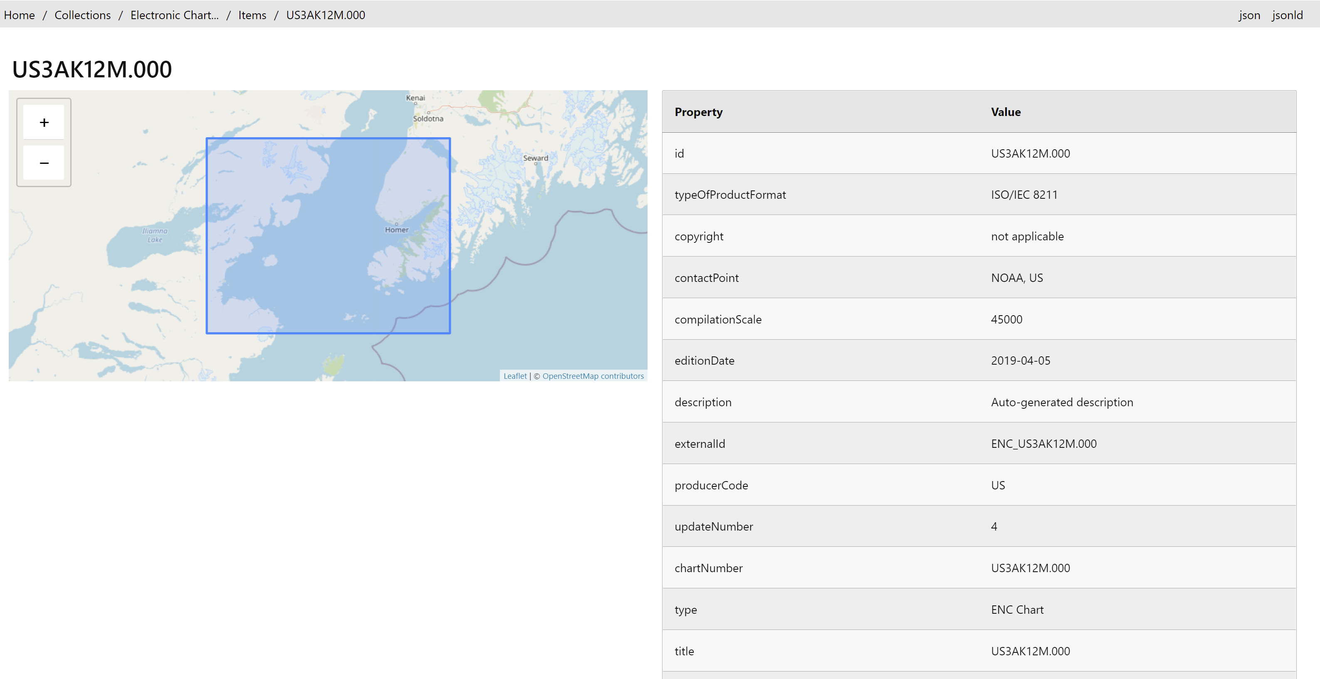
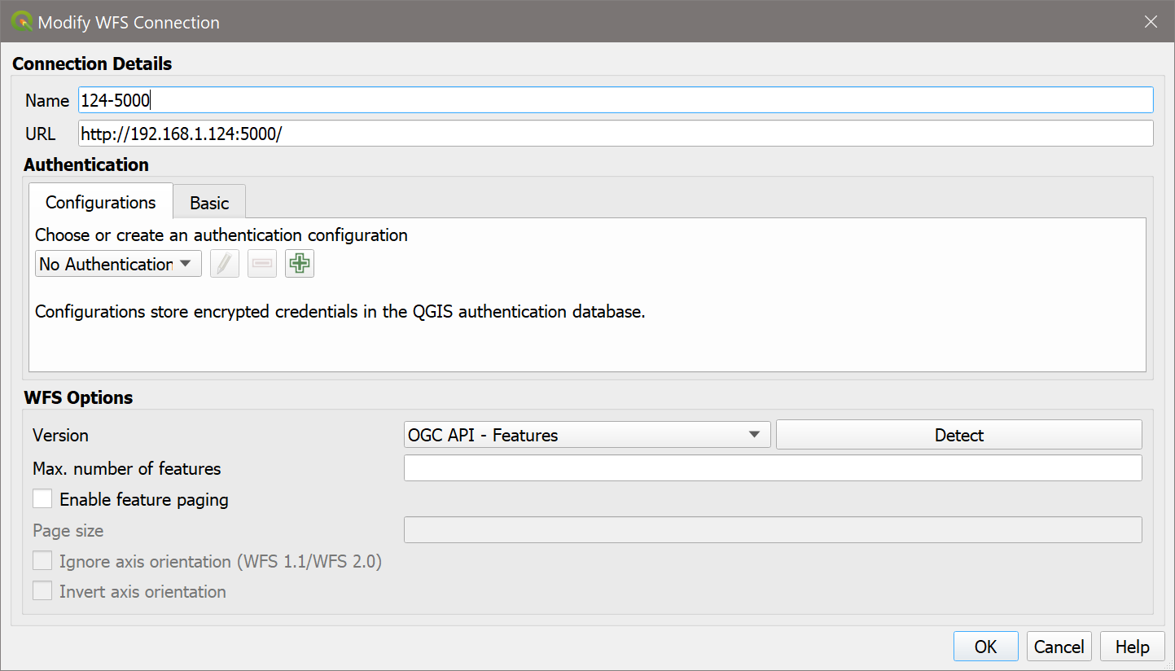
So… this begins to look a bit like a “pipeline”…
GeoJSON
output
ENC data
(s-57 for now)
PRODUCTS.TXT
(metadata file)
Extract Fields
Make OGC Records “feature”
(map fields)
S100DB
tinyDB Catalogue
pygeoAPI
(Records)
OGC API Records
Feature Catalogue

Slide 10
The Plan
Flesh out Metadata record structure for individual IHO data products
Model Other S-100 products where we have data to demonstrate
Map generic OGC API Records fields from IHO metadata (and data) for ENC
In addition to geoJSON extracts, transform IHO Feature Catalogue specs into OAS3 formats
Look deeper into enabling searching (and other enhancements) from pygeoapi
Broaden data (S-111 and S-102 are next)
Look more at discoverability
Best Practices doc
Enhance model. E.g. place names
Previous testbed initiatives
Establish persistent demo system
<S100XC:metadataFileIdentifier>111USA1_CBOFS_20211005T06Z_US4MD1AF.0001</S100XC:metadataFileIdentifier> <S100XC:metadataPointOfContact> <cit:CI_Responsibility> <cit:role> <cit:CI_RoleCode codeList="http://standards.iso.org/iso/19115/resources/Codelists/cat/codelists.xml#CI_RoleCode" codeListValue="publisher">publisher</cit:CI_RoleCode> </cit:role> <cit:party> <cit:CI_Organisation> <cit:name> <gco:CharacterString>NOAA</gco:CharacterString> </cit:name> </cit:CI_Organisation> </cit:party> </cit:CI_Responsibility> </S100XC:metadataPointOfContact> <S100XC:metadataDateStamp>2021-10-05</S100XC:metadataDateStamp> <S100XC:metadataLanguage>English</S100XC:metadataLanguage> <S100XC:S100_19115DatasetMetadata> <gcx:FileName src="MD_111USA1_CBOFS_20211005T06Z_US4MD1AF.XML" >MD_111USA1_CBOFS_20211005T06Z_US4MD1AF.XML</gcx:FileName> </S100XC:S100_19115DatasetMetadata> <S111XC:typeOfCurrentData>hydrodynamicModelForecast</S111XC:typeOfCurrentData> <S111XC:dataCodingFormat>regularGrid</S111XC:dataCodingFormat> <S111XC:methodCurrentsProduct>ROMS_Hydrodynamic_Model_Forecasts</S111XC:methodCurrentsProduct> <S111XC:minDatasetCurrentSpeed>0.0</S111XC:minDatasetCurrentSpeed> <S111XC:maxDatasetCurrentSpeed>0.98</S111XC:maxDatasetCurrentSpeed> </S111_DatasetDiscoveryMetadata>
S-111 Surface Currents Metadata.

Slide 11
